Slide 1
Our Progress
Siti Nurafifah Bte Md Rusli
Alice Yap

Slide 2
Agenda
Brief background information
Pre-Analysis
Creating Shiny App in Rstudio
Writing a Report- subset of repositories
Writing a Report – Regression
Creating Network in Java
What is next?

Slide 3
Study Gnome ecosystem
A historical dataset for the Gnome Ecosystem:
-Study the evolution of social aspect of the Gnome ecosystem(1,418 projects, 11,094 contributors, 1,315,997 commits)
-They are made up of a set of software projects sharing a community of users and contributors.
Hypothesis:
The higher the centralization of authors leads to more committers resulting in high number of commits.

Slide 4
Pre-analysis
Repo-pre-analysis.R (relationship against repository)
People-pre-analysis .R (relationship against people)
Have a better understanding of the relationship between the contributors in the dataset given.
Get familiar with the database.

Slide 5
Creating Shiny app in RStudio
Purpose:
- Turn our analysis into interactive web applications
What do we learn?
Pearson & Spearman correlation coefficients
Building scatterplot to visualize the relationship between two variables

Slide 6
Writing a Report- subset of repositories
To find out the set of repositories to look at
Steps to findings:
Compare the relationship between the individual attributes
Find the third quartile of each attribute
Subset the data according to the set of repositories which consist more than the third quartile
Look at the Pearson & Spearman calculation between each pair
Make conclusion : authors

Slide 7
Writing a Report - Regression
Purpose:
To analyze relationships between independent and dependent variable.
Dependent variable: Repository
Independent variables: Number of commits, committers, authors, files

Slide 8
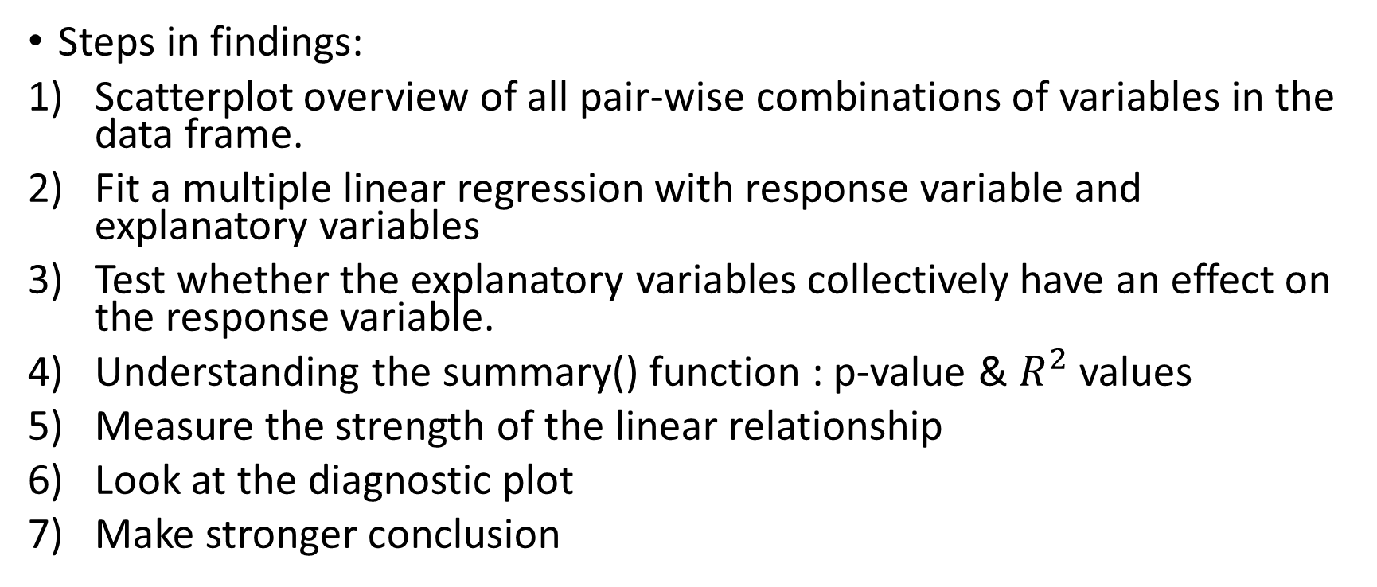
Writing a Report - Regression
Steps in findings:
Scatterplot overview of all pair-wise combinations of variables in the data frame.
Fit a multiple linear regression with response variable and explanatory variables
Test whether the explanatory variables collectively have an effect on the response variable.
Understanding the summary() function : p-value & $R^{2}$ values
Measure the strength of the linear relationship
Look at the diagnostic plot
Make stronger conclusion

Slide 9
Creating Network in Java
Purpose:
Connect & Visualize two vertices(people)
To have a sense of the kinds of network we are interested in.
Steps in findings:
Fetch the query in MySQL
Merge data into “people.csv”
Coding, building the network
Export to Pajek file
Find other network we can generate
Process repeats
So far we have created 2 network, common repo and common commits.

Slide 10
Next….
We will be using igraph to visualise the networks generated.

Slide 11
Thank you

